Slide 1
Solar Cell Characterization
By Adeline Antolis and Malith Rajapakse

Slide 2
What is solar cell characterization?
Quantitave tool to measure the performance of a solar cell
Provides vital information on different factors affect the performance
Composition and microstructure of new materials
Solar cell fabrication process
Used to compare different solar cells
Gives researchers ideas on how to improve a solar cell

Slide 3
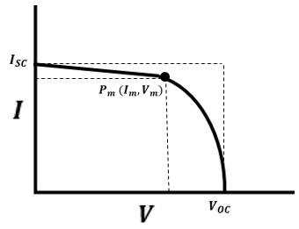


How are solar cells characterized?
Modelling I-V curve (current-voltage) and extracting parameters in the mathematical model
Important points
Short circuit current $I_{SC}$
Open circuit voltage $V_{OC}$
Maximum power point $P_{M}$

Slide 4
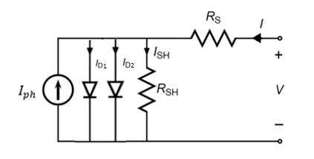
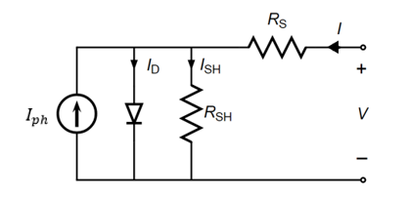
Existing Models
Models of equivalent electrical circuit -Single diode and double diode model

Slide 5

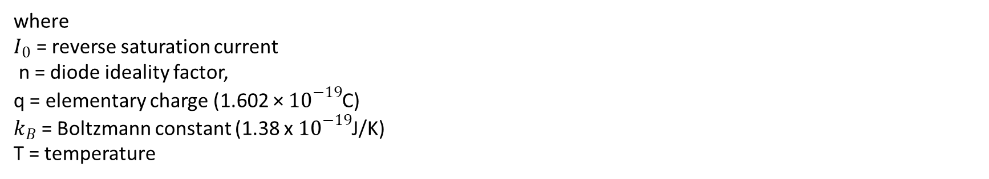
How is the mathematical model obtained?
Single Diode Model
Shockley Diode equation:
(1)
where $I_{0}$ = reverse saturation current n = diode ideality factor, q = elementary charge (1.602 × ${10}^{−19}$C) $k_{B}$ = Boltzmann constant (1.38 x $10^{−19}$J/K) T = temperature

Slide 6
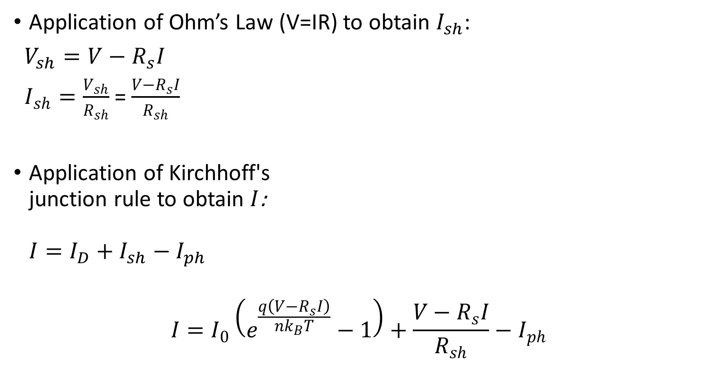
Application of Ohm’s Law (V=IR) to obtain $I_{sh}$:
$V_{sh}=V−R_{s}I$
$I_{sh}=\frac{V_{sh}}{R_{sh}}$ = $\frac{V−R_{s}I}{R_{sh}}$
Application of Kirchhoff's junction rule to obtain $I$: $I=I_{D}+I_{sh}−I_{ph}$
$$I=I_{0}\left(e^{\frac{q\left(V−R_{s}I\right)}{nk_{B}T}}−1\right)+\frac{V−R_{s}I}{R_{sh}}−I_{ph}$$
(2)

Slide 7
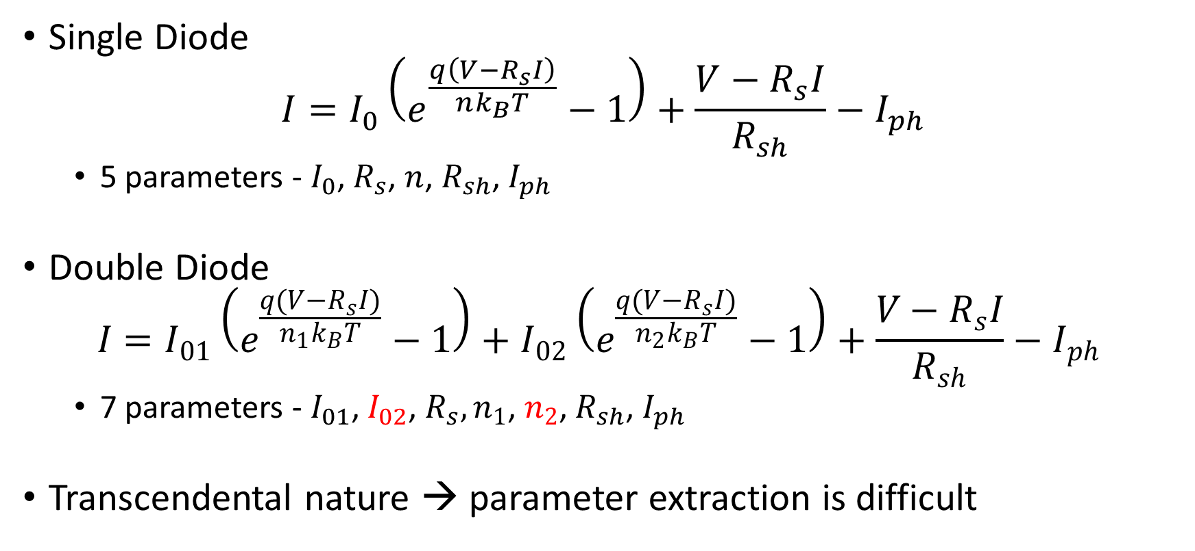
Characteristic equations
Single Diode
$$I=I_{0}\left(e^{\frac{q\left(V−R_{s}I\right)}{nk_{B}T}}−1\right)+\frac{V−R_{s}I}{R_{sh}}−I_{ph}$$
5 parameters - $I_{0}$, $R_{s}$, $n$, $R_{sh}$, $I_{ph}$
Double Diode
$$I=I_{01}\left(e^{\frac{q(V−R_{s}I)}{n_{1}k_{B}T}}−1\right)+I_{02}\left(e^{\frac{q(V−R_{s}I)}{n_{2}k_{B}T}}−1\right)+\frac{V−R_{s}I}{R_{sh}}−I_{ph}$$
7 parameters - $I_{01}$, $I_{02}$, $R_{s}, n_{1}$, $n_{2}$, $R_{sh}$, $I_{ph}$
Transcendental nature → parameter extraction is difficult

Slide 8
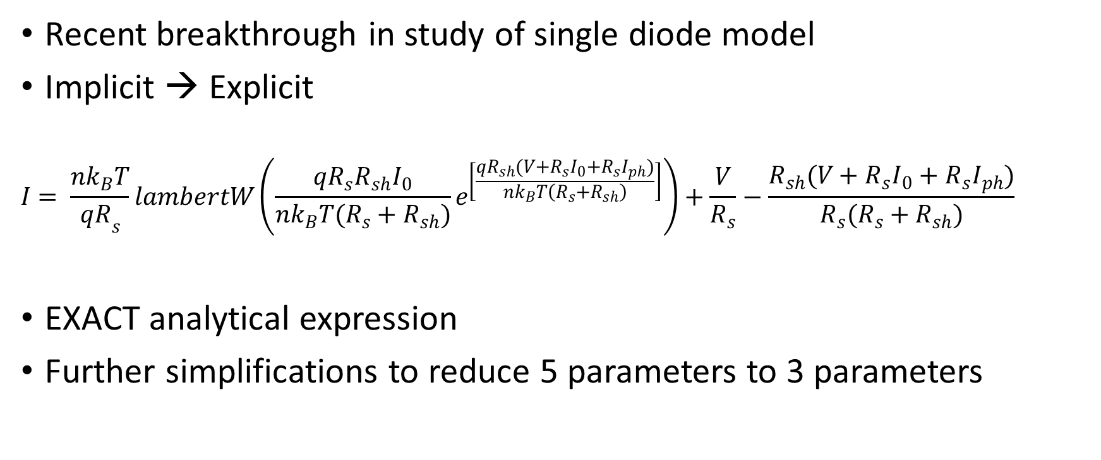
Lambert W Function
Recent breakthrough in study of single diode model
Implicit → Explicit
$$I= \frac{nk_{B}T}{{qR}_{s}}lambertW\left(\frac{qR_{s}R_{sh}I_{0}}{nk_{B}T(R_{s}+R_{sh})}e^{\left[\frac{qR_{sh}(V+R_{s}I_{0}+R_{s}I_{ph})}{nk_{B}T\left(R_{s}+R_{sh}\right)}\right]}\right)+\frac{V}{R_{s}}−\frac{R_{sh}(V+R_{s}I_{0}+R_{s}I_{ph})}{R_{s}(R_{s}+R_{sh})}$$
EXACT analytical expression
Further simplifications to reduce 5 parameters to 3 parameters

Slide 9
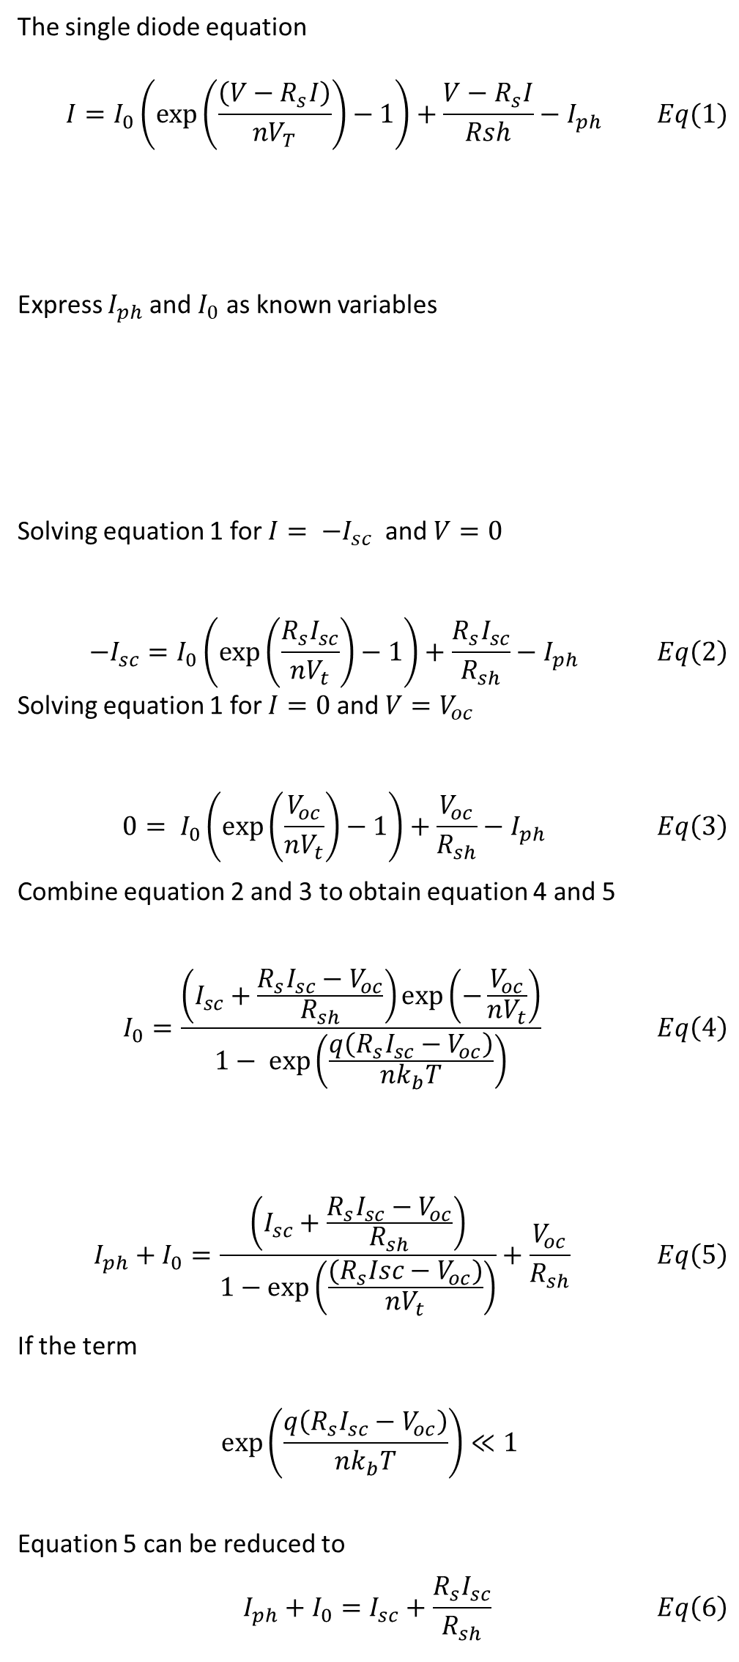
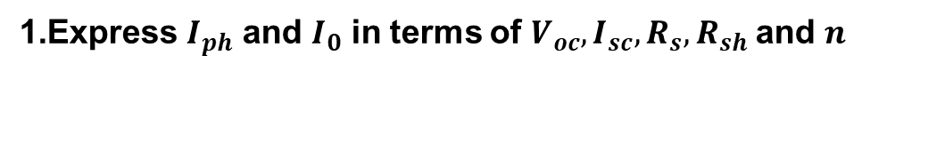
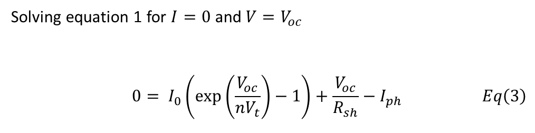
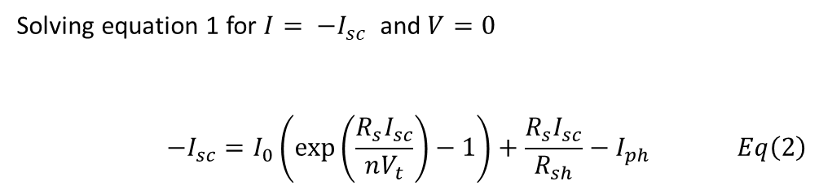
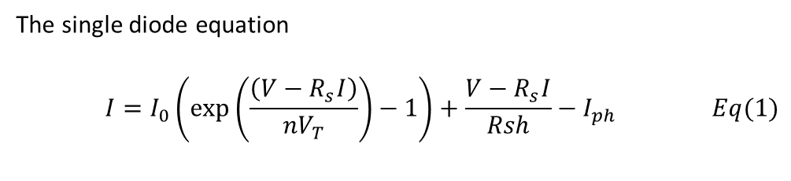
Simplifications
The single diode equation
$$\begin{aligned}I=I_{0}\left(\exp\left(\frac{\left(V−R_{s}I\right)}{nV_{T}}\right)−1\right)+\frac{V−R_{s}I}{Rsh}−I_{ph} \#Eq(1)\end{aligned}$$
Express $I_{ph}$ and $I_{0}$ as known variables
Solving equation 1 for $I= −I_{sc}$ and $V=0$
$$\begin{aligned}−I_{sc}=I_{0}\left(\exp\left(\frac{R_{s}I_{sc}}{nV_{t}}\right)−1\right)+\frac{R_{s}I_{sc}}{R_{sh}}−I_{ph} \#Eq\left(2\right)\end{aligned}$$
Solving equation 1 for $I=0$ and $V=V_{oc}$
$$\begin{aligned}0= I_{0}\left(\exp\left(\frac{V_{oc}}{nV_{t}}\right)−1\right)+\frac{V_{oc}}{R_{sh}}−I_{ph} \#Eq\left(3\right)\end{aligned}$$
Combine equation 2 and 3 to obtain equation 4 and 5
$$\begin{aligned}I_{0}=\frac{\left(I_{sc}+\frac{R_{s}I_{sc}−V_{oc}}{R_{sh}}\right)\exp\left(−\frac{V_{oc}}{nV_{t}}\right)}{1− \exp\left(\frac{q\left(R_{s}I_{sc}−V_{oc}\right)}{nk_{b}T}\right)} \#Eq\left(4\right)\end{aligned}$$
$$\begin{aligned}I_{ph}+I_{0}=\frac{\left(I_{sc}+\frac{R_{s}I_{sc}−V_{oc}}{R_{sh}}\right)}{1−\exp\left(\frac{{(R}_{s}Isc−V_{oc})}{nV_{t}}\right)}+\frac{V_{oc}}{R_{sh}} \#Eq\left(5\right)\end{aligned}$$
If the term $$\begin{aligned}\exp\left(\frac{q\left(R_{s}I_{sc}−V_{oc}\right)}{nk_{b}T}\right)≪1 \end{aligned}$$
Equation 5 can be reduced to
$$\begin{aligned}I_{ph}+I_{0}=I_{sc}+\frac{R_{s}I_{sc}}{R_{sh}} \#Eq\left(6\right)\end{aligned}$$
Express $I_{ph}$ and $I_{0}$ in terms of $V_{oc}, I_{sc}, R_{s},R_{sh}$and $n$
The single diode equation
$$\begin{aligned}I=I_{0}\left(\exp\left(\frac{\left(V−R_{s}I\right)}{nV_{T}}\right)−1\right)+\frac{V−R_{s}I}{Rsh}−I_{ph} \#Eq(1)\end{aligned}$$
Solving equation 1 for $I= −I_{sc}$ and $V=0$
$$\begin{aligned}−I_{sc}=I_{0}\left(\exp\left(\frac{R_{s}I_{sc}}{nV_{t}}\right)−1\right)+\frac{R_{s}I_{sc}}{R_{sh}}−I_{ph} \#Eq\left(2\right)\end{aligned}$$
Solving equation 1 for $I=0$ and $V=V_{oc}$
$$\begin{aligned}0= I_{0}\left(\exp\left(\frac{V_{oc}}{nV_{t}}\right)−1\right)+\frac{V_{oc}}{R_{sh}}−I_{ph} \#Eq\left(3\right)\end{aligned}$$

Slide 10

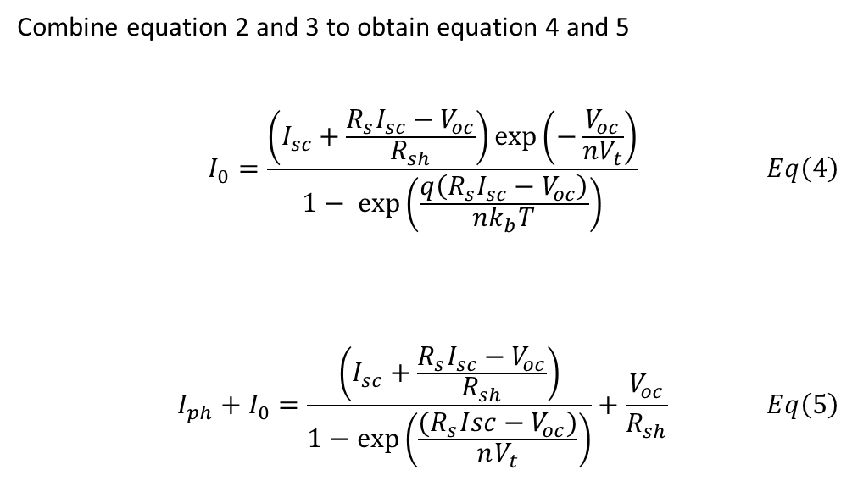
Combine equation 2 and 3 to obtain equation 4 and 5
$$\begin{aligned}I_{0}=\frac{\left(I_{sc}+\frac{R_{s}I_{sc}−V_{oc}}{R_{sh}}\right)\exp\left(−\frac{V_{oc}}{nV_{t}}\right)}{1− \exp\left(\frac{q\left(R_{s}I_{sc}−V_{oc}\right)}{nk_{b}T}\right)} \#Eq\left(4\right)\end{aligned}$$
$$\begin{aligned}I_{ph}+I_{0}=\frac{\left(I_{sc}+\frac{R_{s}I_{sc}−V_{oc}}{R_{sh}}\right)}{1−\exp\left(\frac{{(R}_{s}Isc−V_{oc})}{nV_{t}}\right)}+\frac{V_{oc}}{R_{sh}} \#Eq\left(5\right)\end{aligned}$$
If the term $$\begin{aligned}\exp\left(\frac{q\left(R_{s}I_{sc}−V_{oc}\right)}{nk_{b}T}\right)≪1 \end{aligned}$$
Equation 5 can be reduced to
$$\begin{aligned}I_{ph}+I_{0}=I_{sc}+\frac{R_{s}I_{sc}}{R_{sh}} \#Eq\left(6\right)\end{aligned}$$

Slide 11

Combining simplifications with exact analytical expression for lambert w function
$$I = \frac{nk_{B}T}{{qR}_{s}}W\left(\frac{qR_{s}}{nk_{B}T}({I_{sc}−\frac{V_{OC}}{R_{s}+R_{sh}}e}^{\left[\frac{−qV_{OC}}{nk_{B}T}\right]}e^{\left[\frac{q}{nk_{B}T}(R_{s}I_{sc}+\frac{R_{sh}V}{R_{s}+R_{sh}})\right]}\right)+ \frac{V}{R_{s}}−I_{sc}−\frac{R_{sh}V}{R_{s}(R_{s}+R_{sh})}$$
Only 3 parameters – $R_{s}$, $n$, $R_{sh}$
Parameter extraction is significantly simpler

Slide 12
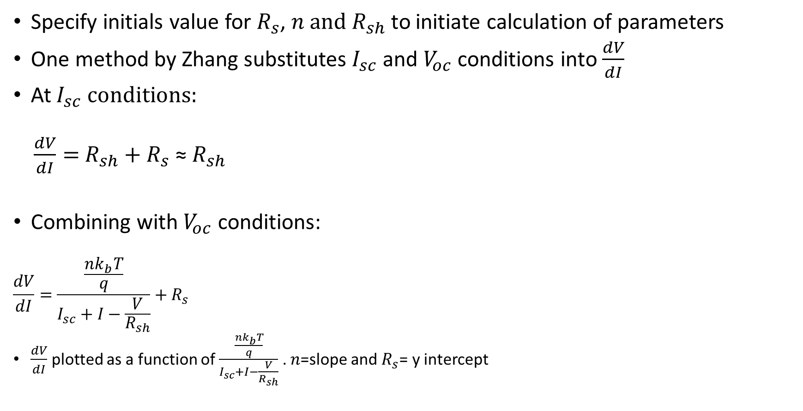
Initial Values
Specify initials value for $R_{s}$, $n \text{and} R_{sh}$ to initiate calculation of parameters
One method by Zhang substitutes $I_{sc}$ and $V_{oc}$ conditions into $\frac{dV}{dI}$
At $I_{sc} conditions:$
$\frac{dV}{dI}=$ $R_{sh}$ $+ R_{s} \text{≈} R_{sh}$
Combining with $V_{oc}$ conditions:
$$\frac{dV}{dI}=\frac{\frac{nk_{b}T}{q}}{I_{sc}+I−\frac{V}{R_{sh}}}+R_{s}$$
$\frac{dV}{dI}$ plotted as a function of $\frac{\frac{nk_{b}T}{q}}{I_{sc}+I−\frac{V}{R_{sh}}}$ . $n$=slope and $R_{s}$= y intercept

Slide 13
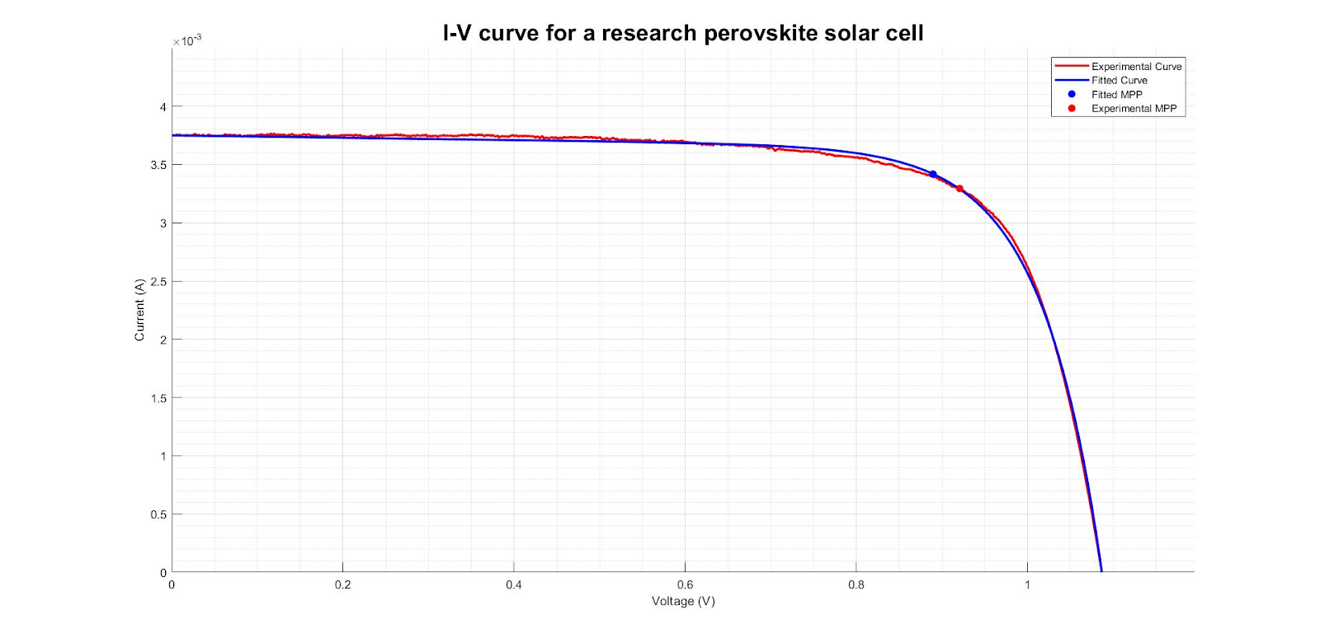
What is the problem?
Extracted Parameters
Rs (Ω) | Rsh (kΩ) | n
-1.28 | 10.00 | 2.88

Slide 14
Problem Statement
Current models for characterization are not reliable enough for high throughput characterization
Negative parameters
Initial guesses in literature are not applicable for all I-V data curves
Too far from the actual solution
Undefined at initial guess
Non realistic parameters extracted
Solutions to these problems mean
More reliable parameter
Help understand the issue causing low fill factor

Slide 15
Possible Solution
Use trust region method
Apply constraints
Constraints derived from assuming one parameter influences the shape of the curve

Slide 16
Objectives
Investigate the ability to extract accurate and sensible $R_{s},R_{sh}$and $n$ for different IV data

Slide 17
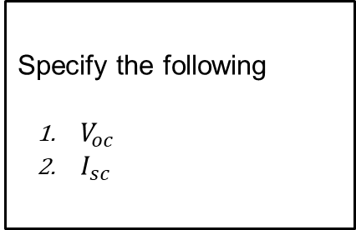
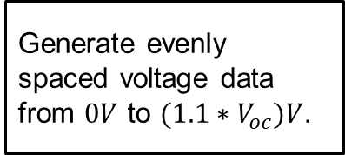
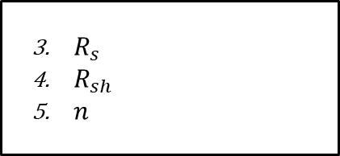
Simulate IV data
Specify the following
$V_{oc}$
$I_{sc}$
Introduce noise with signal to noise ratio (SR) of 45
Generate evenly spaced voltage data from $0V$ to $(1.1∗V_{oc})V$.
Generate current with explicit single diode equation.
$R_{s}$
$R_{sh}$
$n$

Slide 18
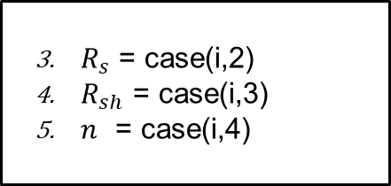
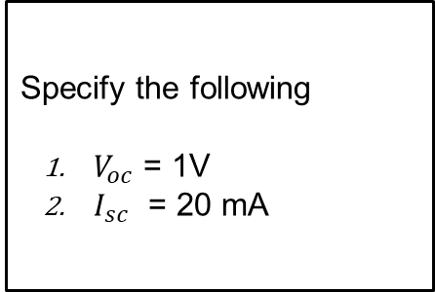
Simulated cases
Case | Rs (Ω) | Rsh (kΩ) | n
1 | 0.10 | 1.00E+03 | 1.00
2 | 25.00 | 1.00E+03 | 1.00
3 | 0.10 | 0.20 | 1.00
4 | 0.10 | 1.00E+03 | 2.50
5 | 25.00 | 1.00E+03 | 2.50
6 | 0.10 | 0.2 | 2.50
7 | 0.10 | 1.00E+03 | 5.00
8 | 25.00 | 0.2 | 5.00
Specify the following
$V_{oc}$ = 1V
$I_{sc}$ = 20 mA
$R_{s}$ = case(i,2)
$R_{sh}$ = case(i,3)
$n$ = case(i,4)

Slide 19
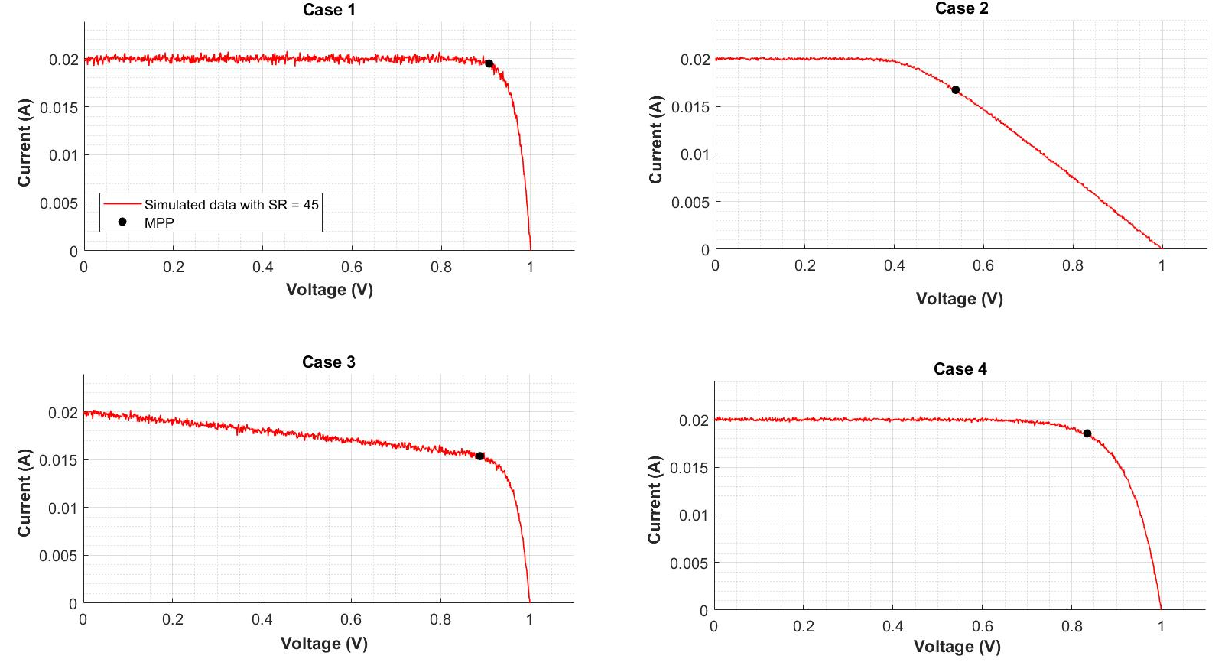
Simulated cases 1 - 4

Slide 20
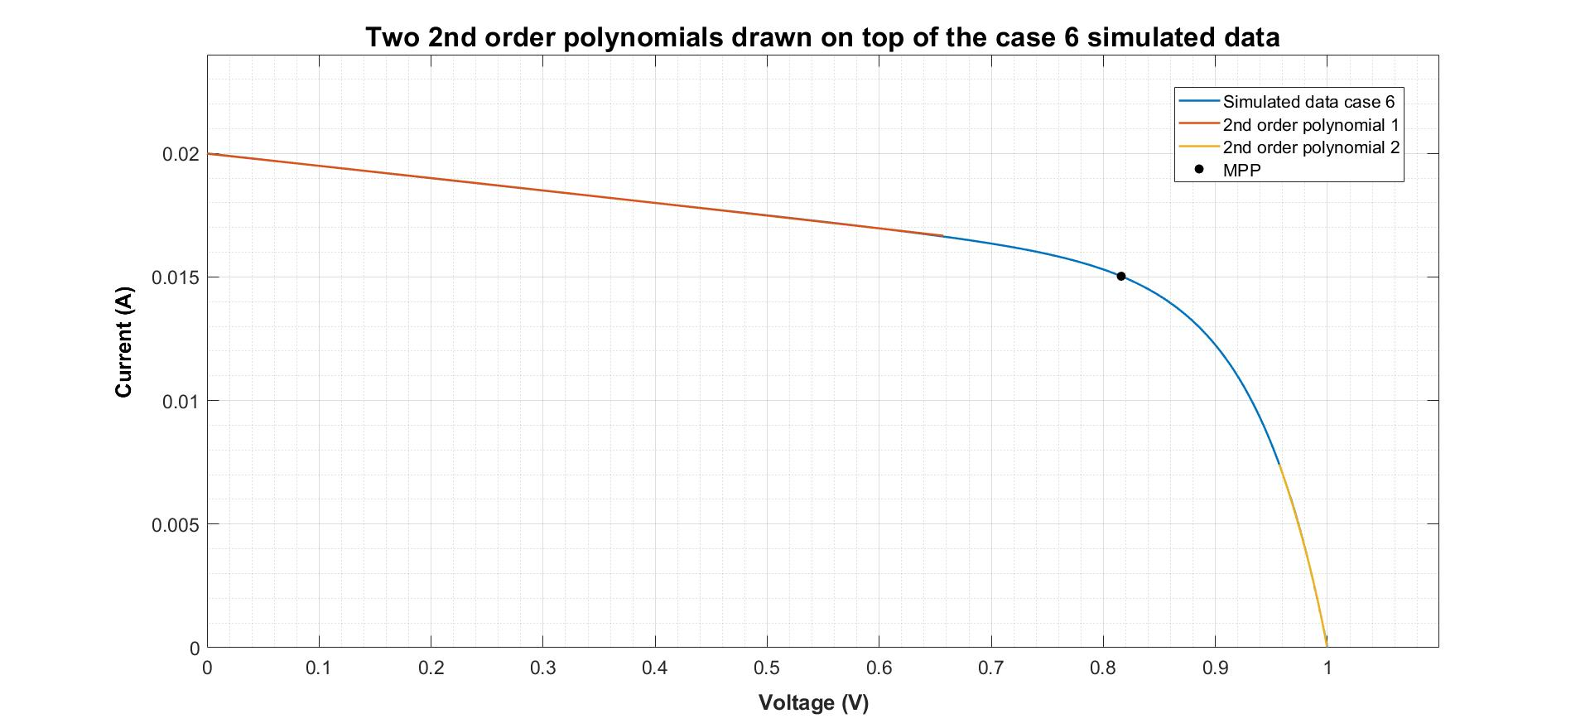


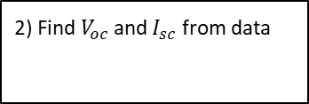
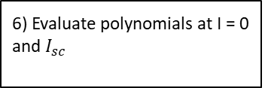

Parameter extraction: Gradients at $V = 0$and $V = V_{oc}$
1) Smooth current data
2) Find $V_{oc}$ and $I_{sc}$ from data
3) Find $V_{m}$ and $I_{m}$
4) Fit data with two 2nd order polynomials
5) Differentiate 2nd order polynomial
6) Evaluate polynomials at I = 0 and $I_{sc}$

